Slide 1
Jointly Distributed Random Variables

Slide 2
Recap..

Slide 3
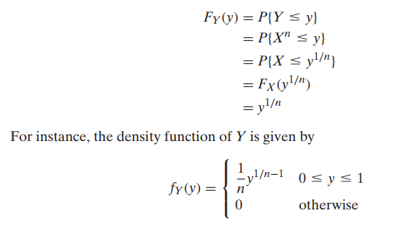

Slide 4
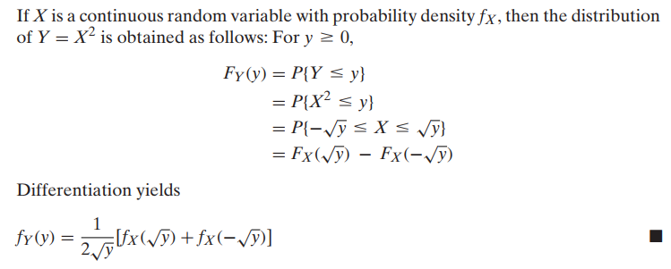

Slide 5
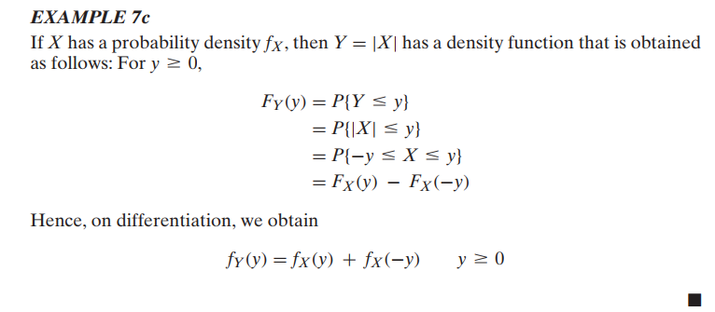

Slide 6

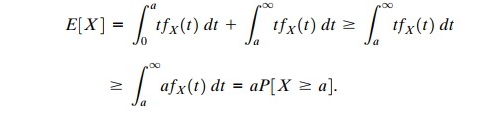
Markov Inequality
Mean of a non-negative random variable X do allow us to obtain bounds for probabilities

Slide 7

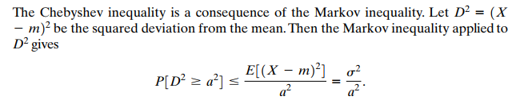

Slide 8

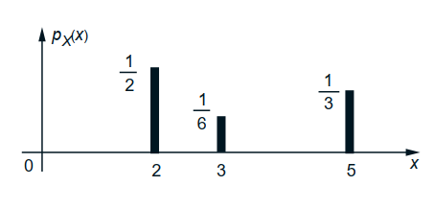


Moment Generating Function

Slide 9

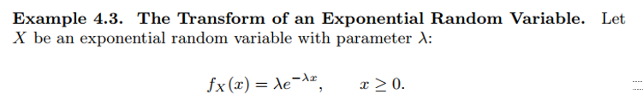
Find MGF of X.

Slide 10
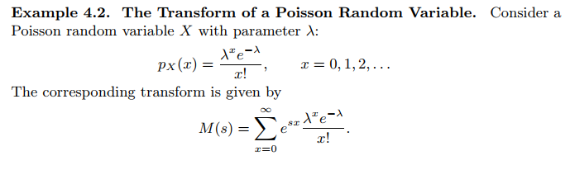
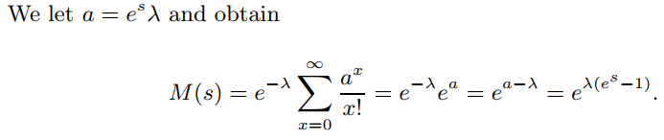

Slide 11
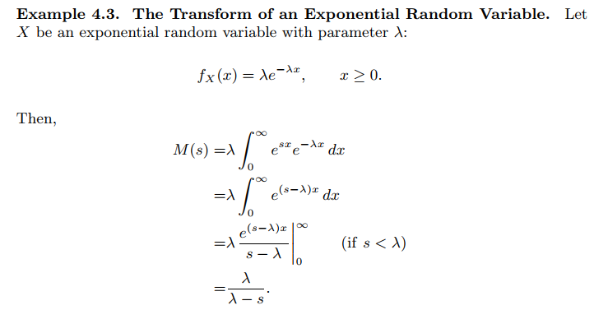

Slide 12
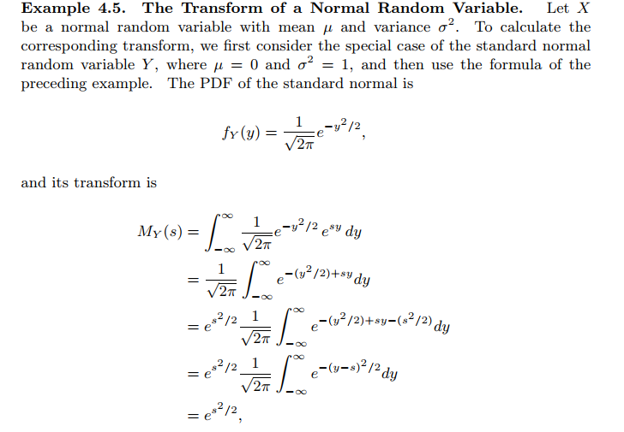

Slide 13
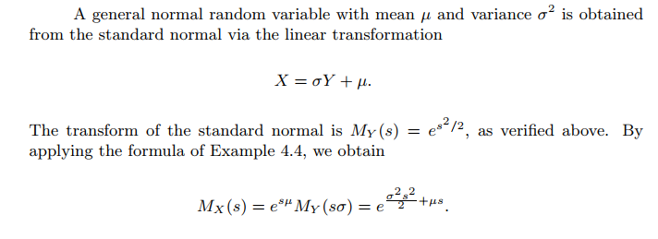

Slide 14
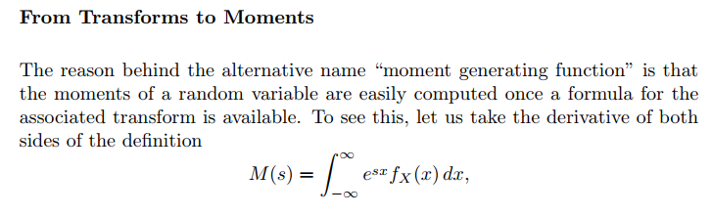
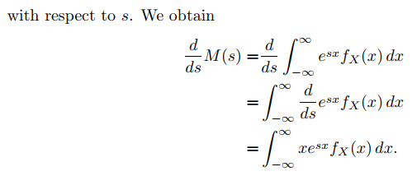

Slide 15
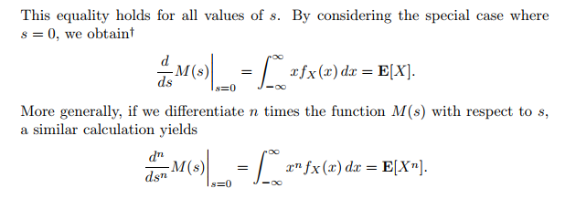

Slide 16
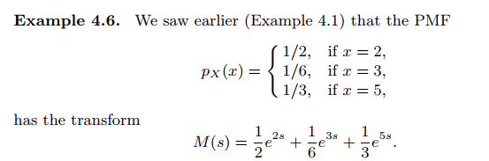
Find mean and variance using MGF

Slide 17
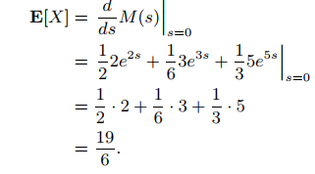
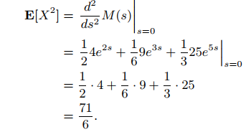

Slide 18
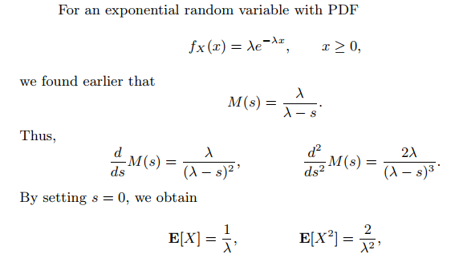

Slide 19
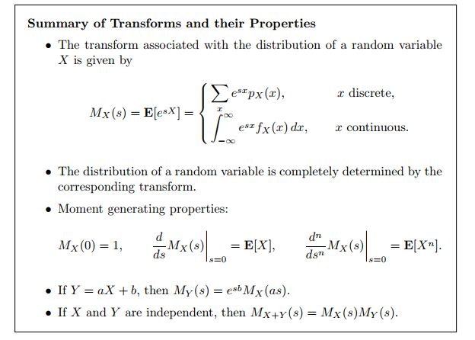

Slide 20
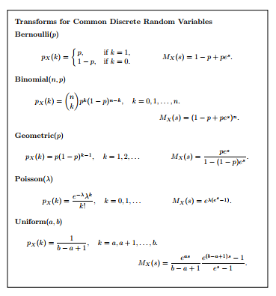

Slide 21
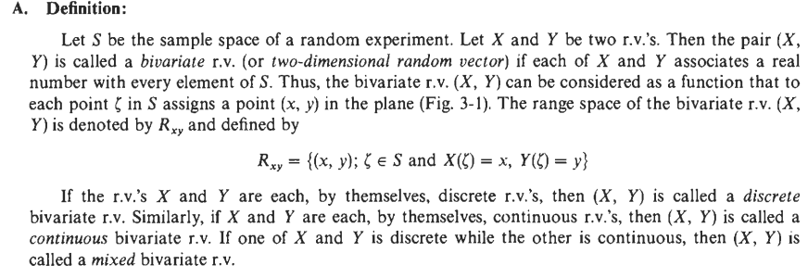
BIVARIATE RANDOM VARIABLES ch-5 Miller Book

Slide 22
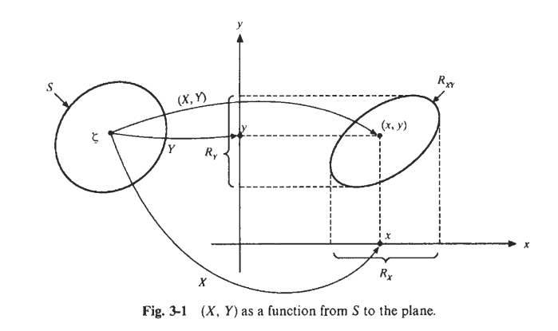

Slide 23
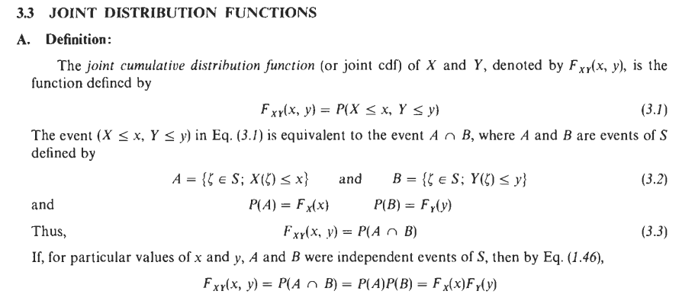

Slide 24
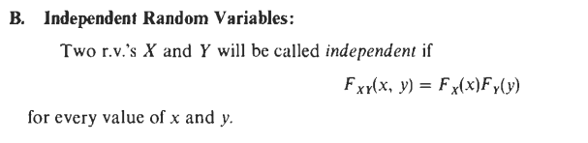

Slide 25
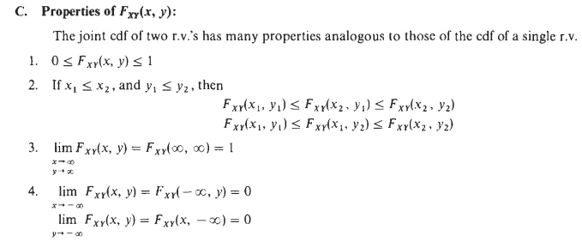

Slide 26
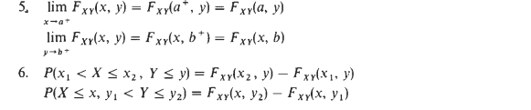


Slide 27
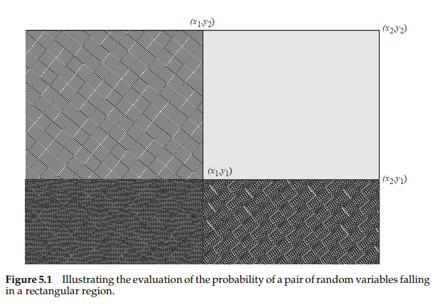

Slide 28
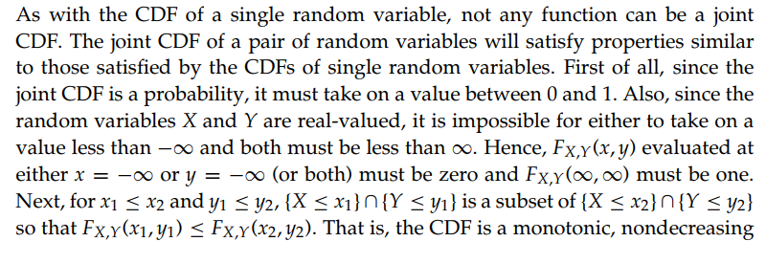
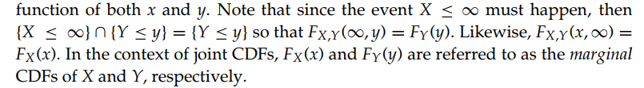
Proof

Slide 29
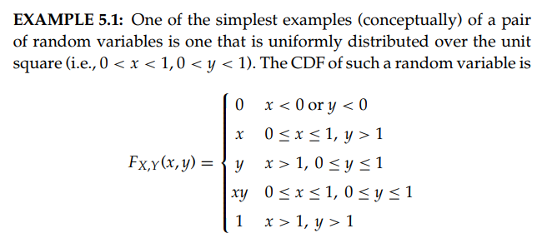
Verify that this function does indeed satisfy all the properties of a joint CDF.
From this joint CDF, find the marginal CDF of X.

Slide 30


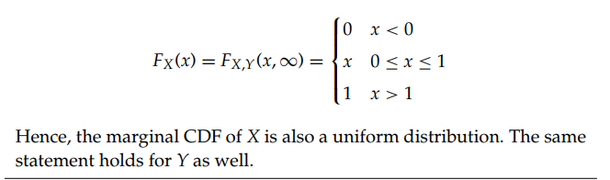

Slide 31
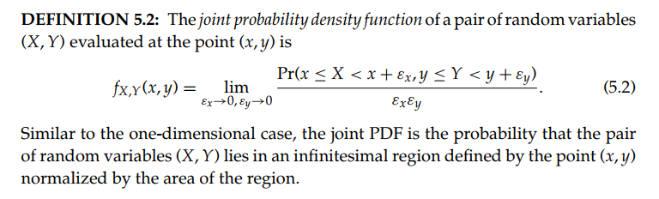
Joint PDF

Slide 32
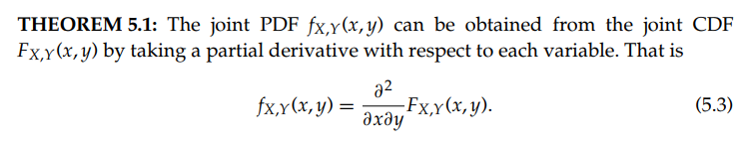

Slide 33
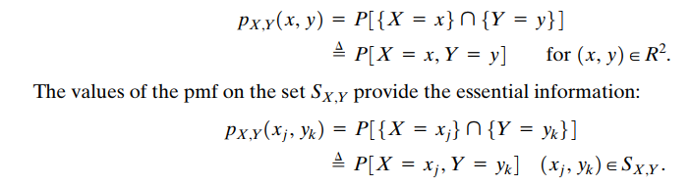
Joint PDF from joint CDF

Slide 34
Jointly Distributed RVs
In general, if X and Y are two random variables, the probability distribution that defines their simultaneous behavior is called a joint probability distribution.
For example: X : the length of one dimension of an injection-molded part, and Y : the length of another dimension. We might be interested in
P(2.95 ≤ X ≤ 3.05 and 7.60 ≤ Y ≤ 7.80).

Slide 35
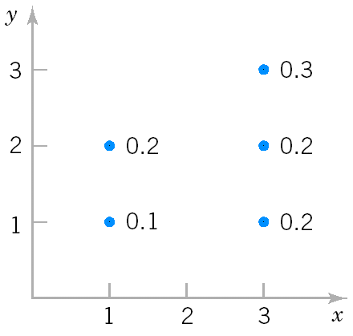
Discrete Joint Probability Distributions
The joint probability distribution of two discrete random variables X,Y is usually written as f_{XY}(x,y)= Pr(X=x, Y=y). The joint probability function satisfies
Example 6: X can take only 1 and 3; Y can take only 1,2 and 3 ; and the joint probability function of X and Y is:
Compute P(X≥2, Y≥2)
(2) Compute P(X=3)
Joint distribution of X and Y

Slide 36
Compute P(X≥2, Y≥2)
P(X≥2, Y≥2)=P(X=3,Y=2)+P(X=3,Y=3)=0.2+0.3=0.5
(2) Compute Pr(X=3)
P(X=3)=P(X=3,Y=1)+P(X=3,Y=2)+P(X=3,Y=3)=0.2+0.2+0.3=0.7

Slide 37
Marginal Probability Distributions (Discrete)
Marginal Probability Distribution: the individual probability distribution of a random variable computed from a joint distribution.
Notes:
In other words, for every value x, the value of fX(x) is found by summing fXY(x,y) over all possible values y of Y.

Slide 38
Marginal Probability Distributions (Discrete, Example)
Compute f_{X}(1), f_{X}(3), f_{Y}(1), f_{Y}(2) and f_{Y}(3) in Example 6 .
f_{X}(1)=P(X=1,Y=1)+P(X=1,Y=2)=0.1+0.2=0.3
f_{X}(3)= P(X=3,Y=1)+P(X=3,Y=2)+ P(X=3,Y=3)=0.2+0.2+0.3=0.7
f_{Y}(1)= P(X=1,Y=1)+P(X=3,Y=1)=0.1+0.2=0.3
f_{Y}(2)=P(X=1,Y=2)+P(X=3,Y=2)=0.2+0.2=0.4
f_{Y}(3)= P(X=3,Y=3)=0.3

Slide 39
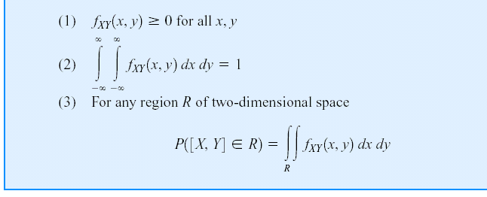
Continuous Joint Distributions
A joint probability density function for the continuous random variables X and Y, denotes as f_{XY}(x,y), satisfies the following properties:

Slide 41
Continuous Joint Distributions (Example 7)
Calculating probabilities from a joint p.d.f.

Slide 42
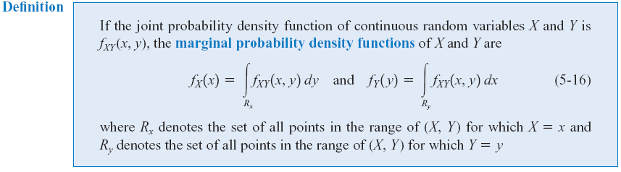
Marginal Probability Distributions(Continuous)
Similar to joint discrete random variables, we can find the marginal probability distributions of X and Y from the joint probability distribution.

Slide 43
Marginal Probability Distributions(Continuous, Example)
Compute f_{X} (x) and f_{Y}(y) in Example 7

Slide 44
Independence
In some random experiments, knowledge of the values of X does not change any of the probabilities associated with the values for Y.
If two random variables, X and Y are independent, then

Slide 45
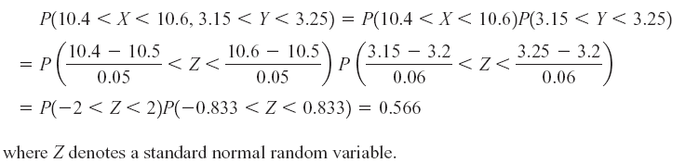
Independence (Example 8)
Let the random variables X and Y denote the lengths of two dimensions of a machined part, respectively.
Assume that X and Y are independent random variables, and the distribution of X is normal with mean 10.5 mm and variance 0.0025 (mm)² and that the distribution of Y is normal with mean 3.2 mm and variance 0.0036 (mm)².
Determine the probability that 10.4 < X < 10.6 and 3.15 < Y < 3.25.
Because X,Y are independent

Slide 46
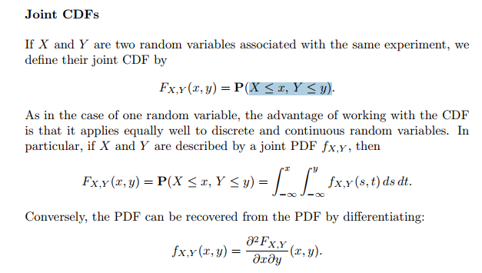

Slide 47

Function of random Variable Find the CDF and PDF of Y

Slide 48
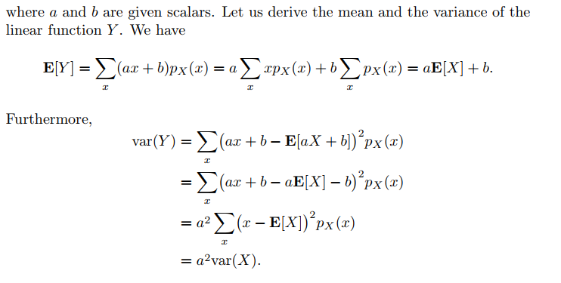

Slide 50
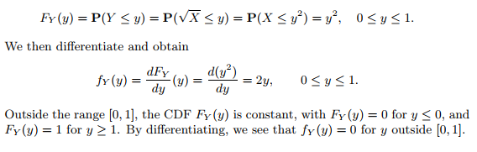

Slide 51


Slide 52
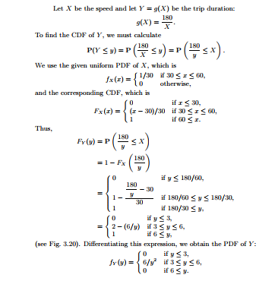

Slide 53
Covariance and Correlation Coefficient
The covariance between two RV’s X and Y is
Properties:
The correlation Coefficient of X and Y is
Notes:
When we are interested in the joint distribution of two random variables, it is useful to have a summary of how much the two random variables depend on each other. The covariance and correlation are attempts to measure that dependence.

Slide 54
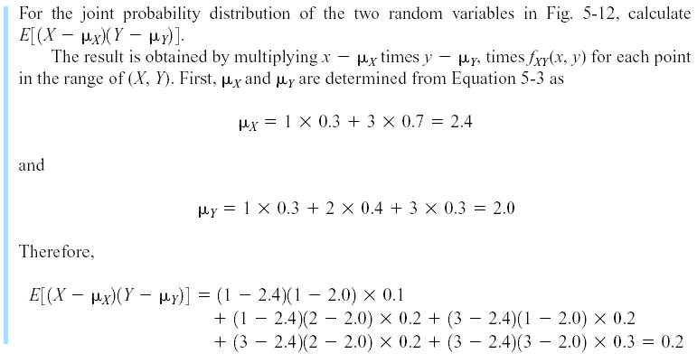
Covariance and Correlation (Example 6 (Cont.))
Marginal PMF
f_{X}(1)=P(X=1,Y=1)+P(X=1,Y=2)=0.1+0.2=0.3
f_{X}(3)= P(X=3,Y=1)+P(X=3,Y=2)+ P(X=3,Y=3)=0.2+0.2+0.3=0.7
f_{Y}(1)= P(X=1,Y=1)+P(X=3,Y=1)=0.1+0.2=0.3
f_{Y}(2)=P(X=1,Y=2)+P(X=3,Y=2)=0.2+0.2=0.4
f_{Y}(3)= P(X=3,Y=3)=0.3

Slide 55
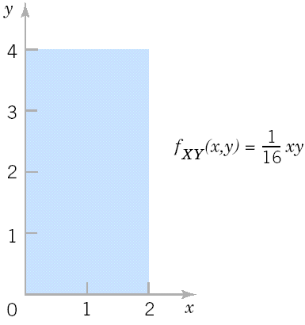
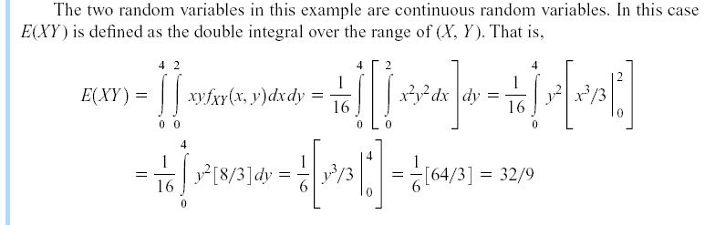
Covariance and Correlation
Example 9

Slide 56
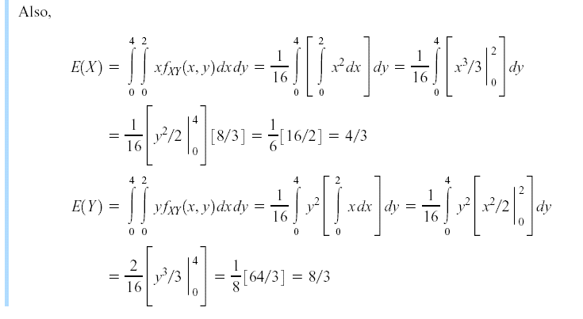
Covariance and Correlation
Example 9 (Cont.)

Slide 57
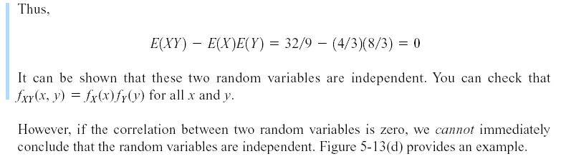
Covariance and Correlation
Example 9 (Cont.)

Slide 58
Zero Covariance and Independence
However, in general, if Cov(X,Y)=0, X and Y may not be independent.
Example 10: X is uniformly distributed on [-1,1], Y=X² . Then,
Cov(X,Y)= 0, but X determines Y, i.e., X and Y are not independent.
If X and Y are independent, then Cov(X,Y)=0.

Slide 59
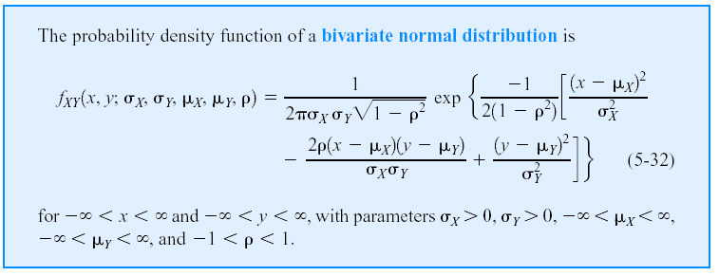
Bivariate Normal Distribution
Notes:
ρ: Correlation coefficient X, Y are independent if ρ = 0
The bivariate normal distribution is the joint distribution of certain linear combinations of independent random variables havign standard normal distributions. The bivariate normal distribution arises directly and naturally in many practical problems. For examle, the heights and the weights of the individuals in the population will be approximately a bivariate normal distribution.

Slide 60
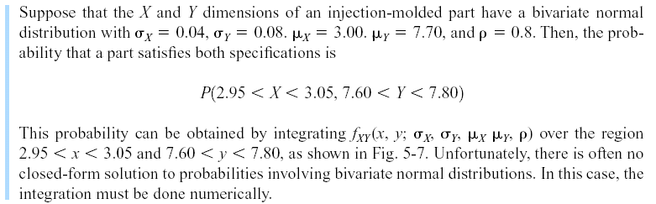
Bivariate Normal Distribution
Example 11
Notes:
Unfortunately, there is often no closed-form solution to probabilities involving bivariate normal distributions. In this case, the integration must be done numerically.

Slide 61
Bivariate Normal Distribution (Matlab)
y = mvncdf(xl,xu,mu,SIGMA) returns the multivariate normal cumulative probability with mean mu and covariance SIGMA evaluated over the rectangle with lower and upper limits defined by xl and xu, respectively. mu is a 1-by-d vector, and SIGMA is a d-by-d symmetric, positive definite matrix.
Examples 11 (Cont.)
mu=[3.00 7.70]; SIGMA=[0.0016 0.00256; 0.00256 0.0064];
XL=[2.95 7.60];
XU=[3.05 7.80];
>> p=mvncdf(XL,XU, mu,SIGMA)
p =
0.6975

Slide 62
Probability Distributions-II: Multidimensional Random Variables, DFs, Marginal Distributions, Discrete and Continuous Random Variables in two dimensions, Conditional Distributions, Transformation of continuous random variables in two dimensions. ● Mathematical Expectation-II: Expectation of Two-dimensional Distributions, Moments, Covariance and Correlation Coefficients, Conditional Expectations-Regression Curves, Principle of Least Squares-Regression Lines, M.G.F., Joint Characteristic Functions, Reproductive Property. ● Convergence of a Sequence of Random Variables and Limit Theorems: Convergence in Probability and Convergence in Distribution, Tchebycheff’s Inequality and Theorem, Bernoulli’s Theorem, Law of Large Numbers. Asymptotically Normal Distribution, Limit Theorem for Characteristic Functions, Central Limit Theorem, DeMoivre Laplace Limit Theorem. ● Some Important Continuous Distributions: Chi-square Distribution, t-Distribution, F Distribution and important statistics.

